Slide 1


Slide 2
BIBLE READING
1 Chronicles 16:7–12
Psalm 100

Slide 3
What shall I render unto
the Lord?

Slide 4
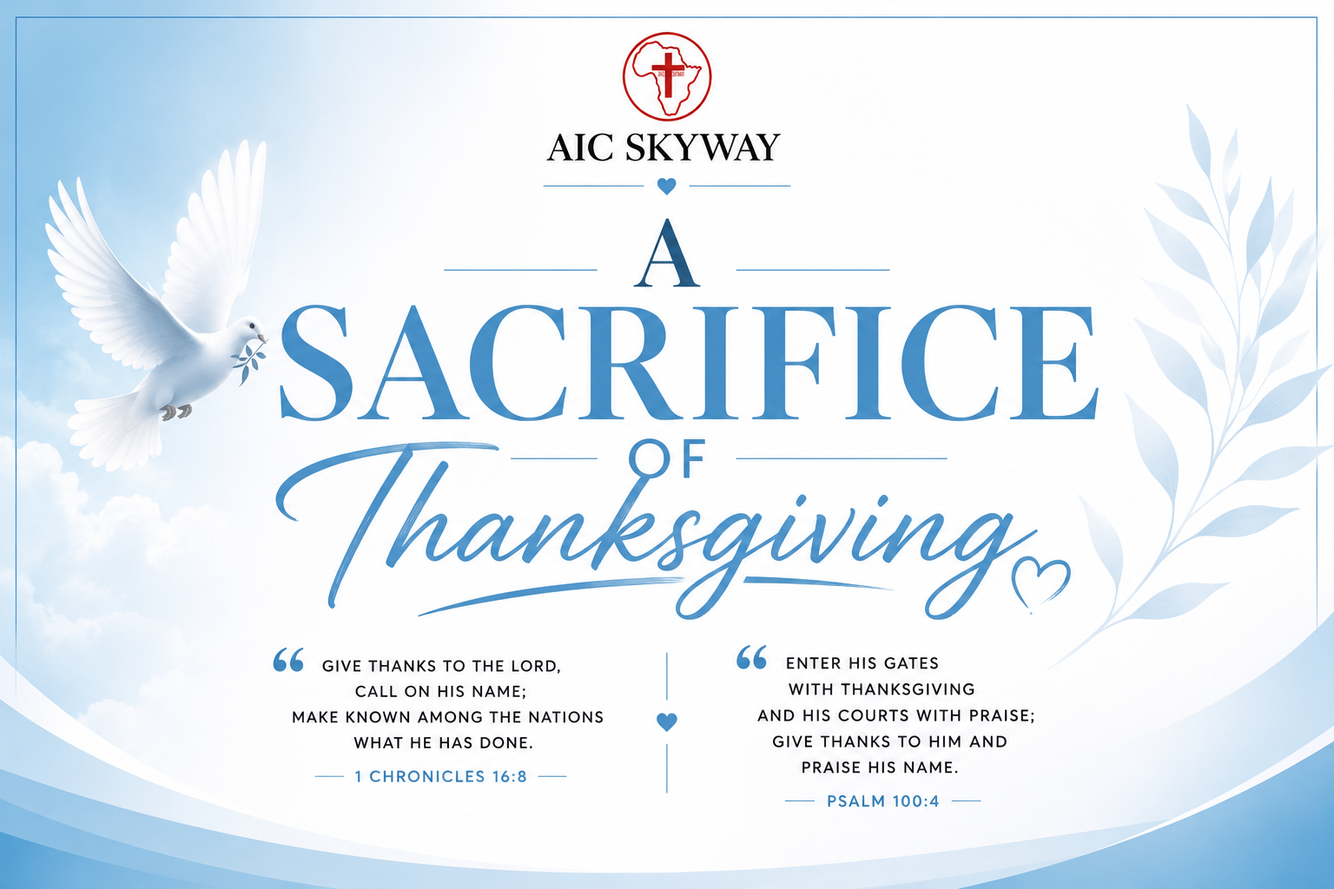

Slide 5
Why was David so thankful?
The Ark had been captured by the Philistines.
The Ark represented God's holy presence among His people.
David's first attempt failed because God's holiness was ignored.
After obeying God's instructions, the Ark was finally brought to Jerusalem.
David responded not with pride but with thanksgiving, worship, sacrifice, and praise..

Slide 6
1 Chronicles 16: 7 -12
David's Psalm of Thanksgiving
Instructions to give thanks:- David appoints Asaph and Levites to sing, calling the people to give thanks to the Lord and call on His name, making His deeds known among the nations.
Call to worship:- sing to Him, sing praises, and tell of all His wondrous works.
Glory in His name:- rejoice in the Lord, seek Him and His strength continually.
Remember His works:- recall the wonders, miracles, and judgments He has performed.

Slide 7
Psalm 100
A Psalm for Giving Thanks.
Call to worship:- an invitation to shout joyfully to the Lord, serve Him with gladness, and come before Him with singing.
Recognition of God:- the psalmist reminds us that the Lord is God, that He made us, and that we belong to Him as His people and sheep of His pasture.
Invitation to the temple:- Enter His gates with thanksgiving and His courts with praise; give thanks to Him and bless His name.
Reason for praise:- the Lord is good, His steadfast love endures forever, and His faithfulness continues through all generations.

Slide 8
Life Lessons
1. Thanksgiving begins with praise
Praise is the language of gratitude. David instructed the people to: Give thanks unto the LORD, call upon His name; make known His deeds among the people.
2. Thanksgiving is expressed through worship
Worship is one of the highest expressions of gratitude and David's thanksgiving was visible……He worshipped, Sacrificed, Sang and Served.

Slide 9
3. Thanksgiving grows through remembering
Remembering God's past faithfulness builds confidence for the future.…..Legacy Review, journal. God's people are called to remember His works and trust His promises.
  Forgetfulness leads to complaining; remembrance fuels gratitude.…….Trigger and turn rule
4. Thanksgiving should be shared
David did not celebrate alone.......He invited the whole nation. Everyone rejoiced, received food and participated in worship. Your testimony may become someone else's encouragement and strengthen faith.

Slide 10
CONCLUSION
What shall I render unto the Lord?
We cannot repay /bribe/corrupt God for all He has done. We will bring Him a Sacrifice of Thanksgiving not only with our lips, but with joyful worship, faithful service, grateful hearts, and lives that proclaim His goodness every day ……Hebrews 13:15-16
A thankful heart naturally praises God.

Slide 11
"Matthew Henry said, 'Thanksgiving is good, but thanksliving is better.' May our gratitude not end with today's worship, but be seen in the way we live for Christ every day."

